Slide 1

Lead Score Case Study
Submitted by
Apeksha khare , Suganya Balaji
and Venkata Hemanth Gubbala

Slide 2
Problem Statement
X Education sells online courses to industry professionals
X Education gets a lot of leads, its lead conversion rate is very poor. For example, if, say, they acquire 100 leads in a day, only about 30 of them are converted.
To make this process more efficient, the company wishes to identify the most potential leads, also known as ‘Hot Leads’.
If they successfully identify this set of leads, the lead conversion rate should go up as the sales team will now be focusing more on communicating with the potential leads rather than making calls to everyone.
Business Objective:
X education wants to know most promising leads.
For that they want to build a Model which identifies the hot leads.
Deployment of the model for the future use.
The target lead conversion rate is around 80%.

Slide 3

Case Study Approach
Understanding Problem statement
Understanding Data
Data Cleaning by handling missing values and unique variables.
Exploratory Data Analysis by performing Univariate , Bivariate and Multi-variate analysis
Data interpretation
Data preparation for Modelling
Logistic regression Model building
Model Evaluation
Conclusion

Slide 4
Data Cleaning and Manipulation
The unique columns were identified and dropped the columns that has single unique values which is least important for the analysis.
Some of the categorical columns had value as “select”, which is equivalent to null values and handled it by replacing it as “Not Available”.
The columns containing null values were identified and dropped the columns having more than 35% null values.
The rows that had least null values (less than 1.5%) were dropped.

Slide 5
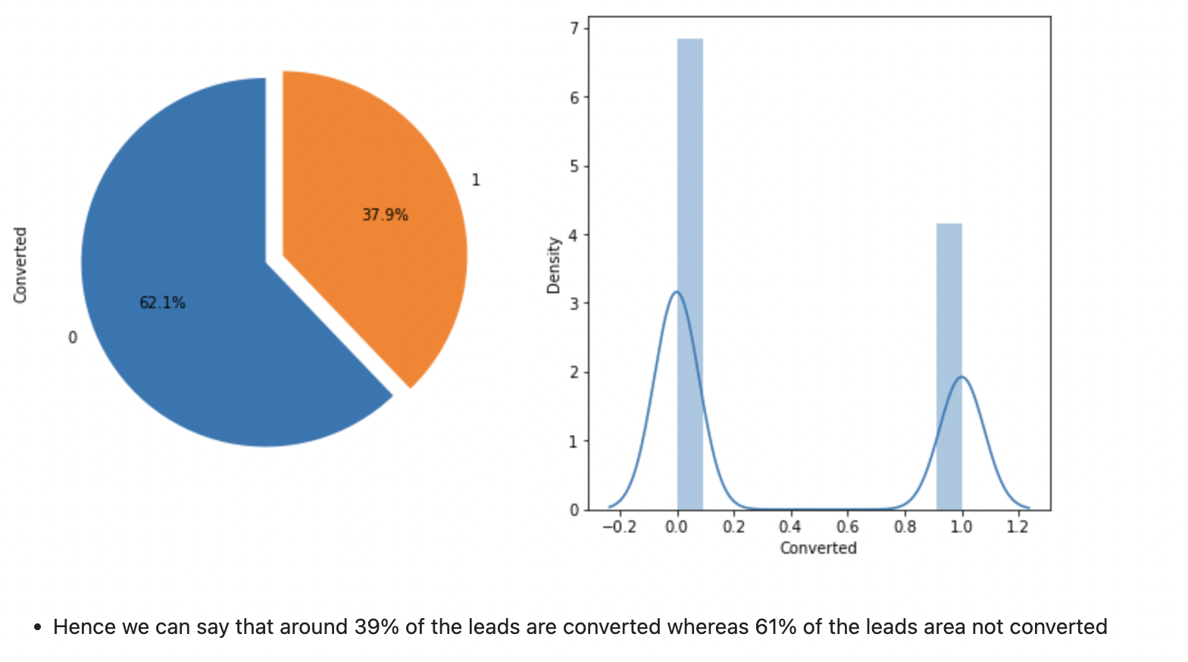
EDA

Slide 6
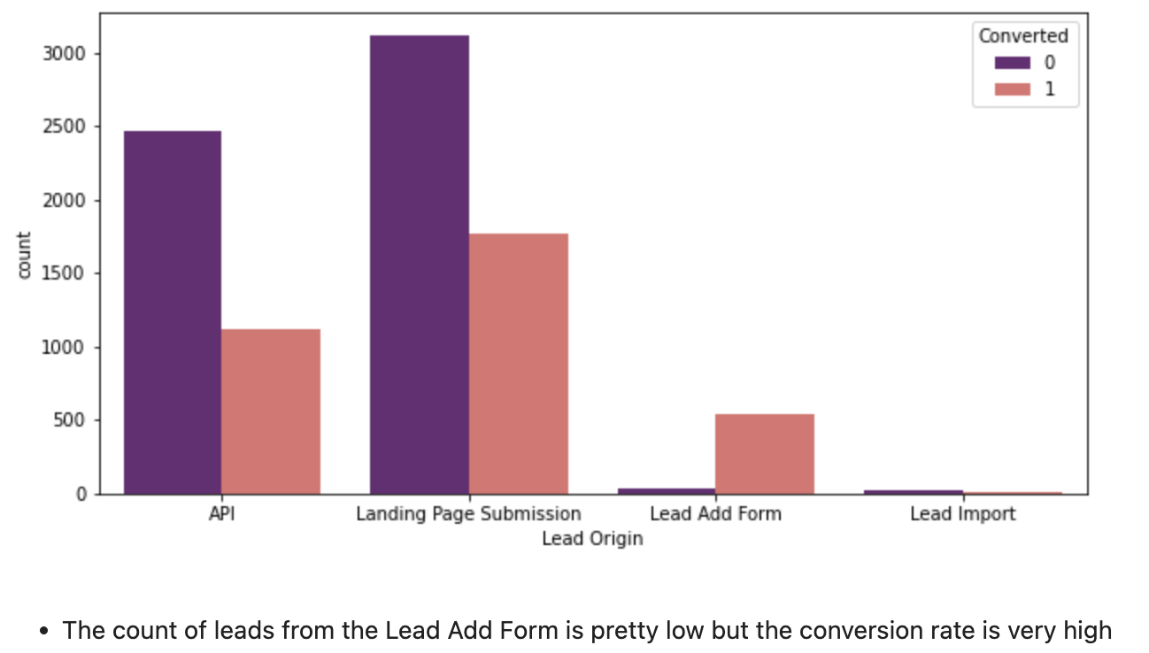
Lead Source

Slide 7
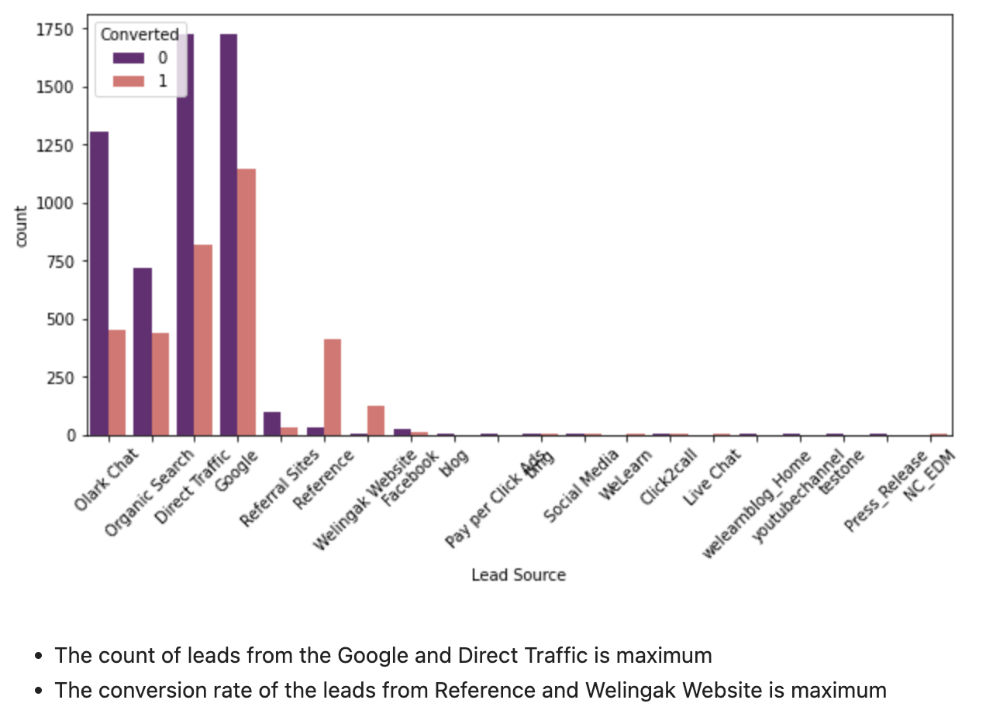

Slide 8
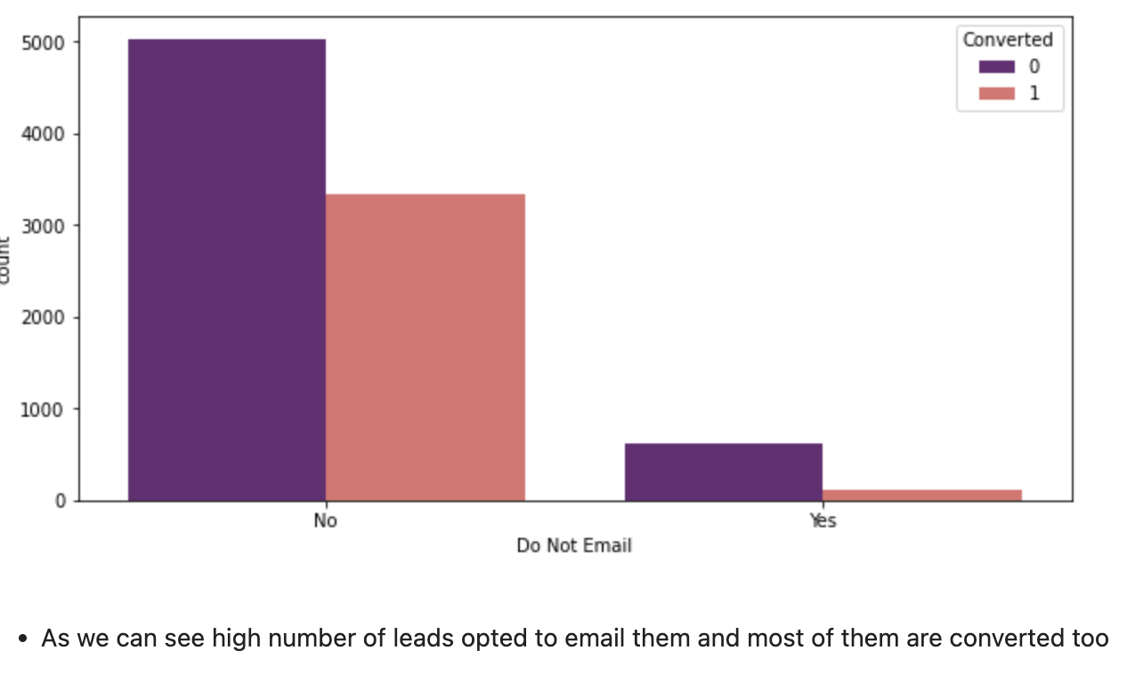
Lead
Preference
:

Slide 9
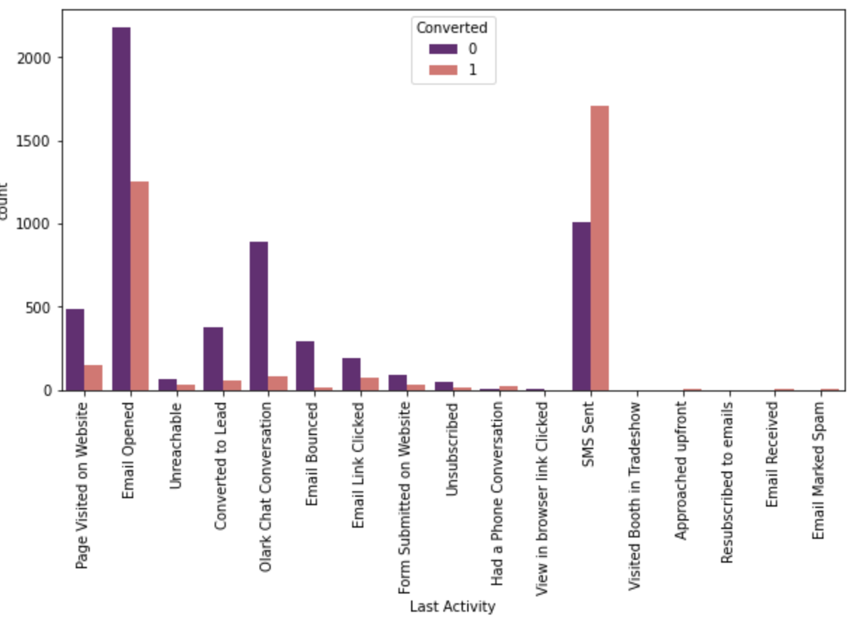
The lead Conversion rate is higher when the information sent via SMS

Slide 10
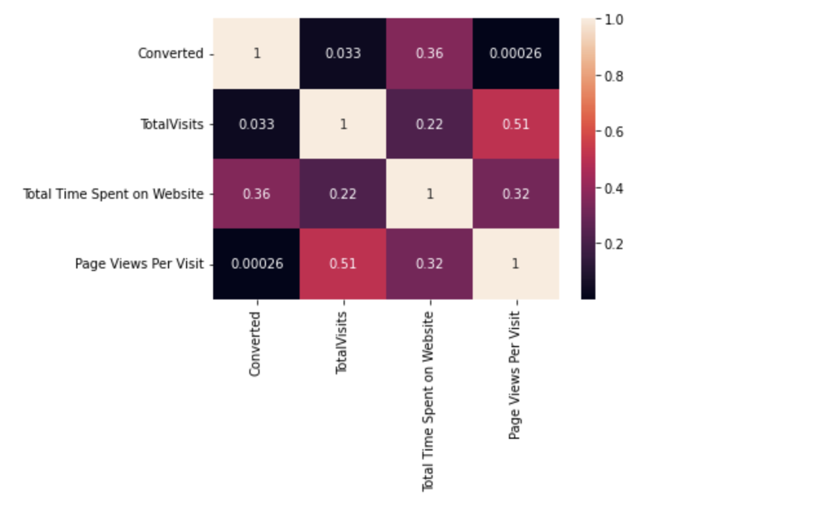
There is relatively a higher corelation for total visits
and page views per visit

Slide 11
Data Preparation
Dummy Variables are created for object type variables
Total Rows for Analysis: 9074
Total Columns for Analysis: 20

Slide 12
Model Building
Train - Test split was done at 70% and 30% respectively.
RFE was done to attain the top 15 relevant variables.
Removed variables manually depending on the VIF values and p-value.
Predictions on test data set
Overall accuracy 81%

Slide 13
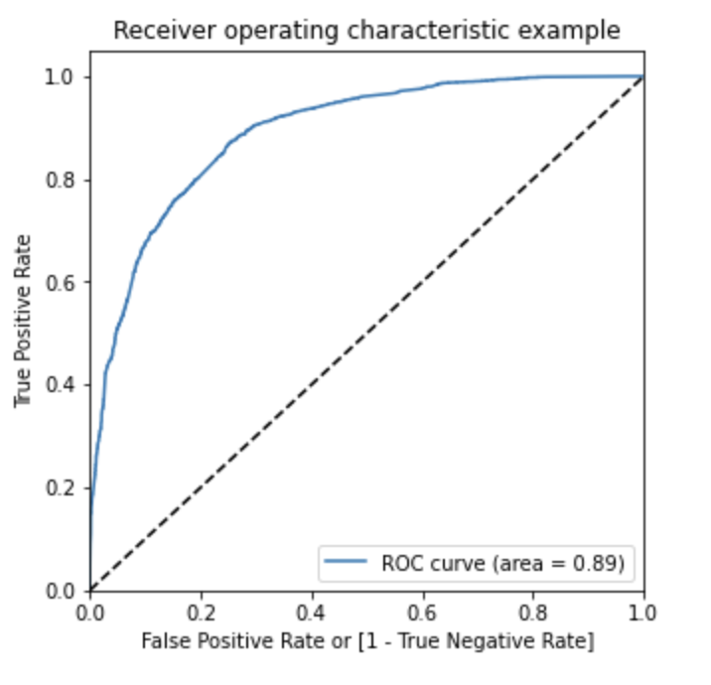
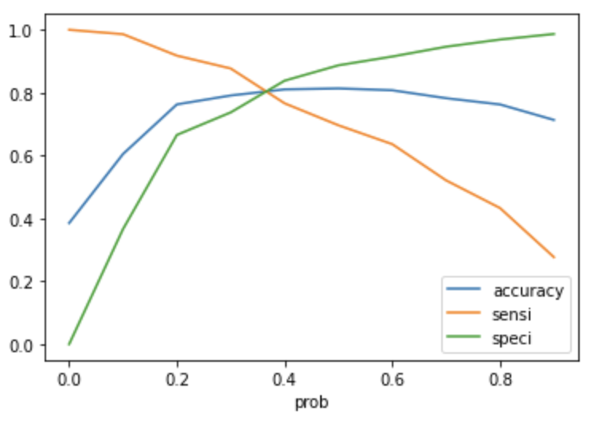
RoC Curve
From the second graph it is visible that the optimal cut off is at 0.35.

Slide 14
Conclusion
The probability of lead getting converted is high when ‘Lead Origin’ is ‘Lead add form
Large number of leads come from Google and direct traffic but referral sites convert most lead conversions.
Leads opting for emailing option have more probability of getting converted.
Conversion rate is higher when the information is sent through SMS.
Unemployed people have more conversion rate as well as more count.
The model gives accuracy of 81%.
The optimal cutoff comes out to be 0.35
With the help of this model if the sales team contact only the leads with high lead score, their conversion rate will increase to more than 80% as expected.

